Slide 1
Image captioning

Slide 2
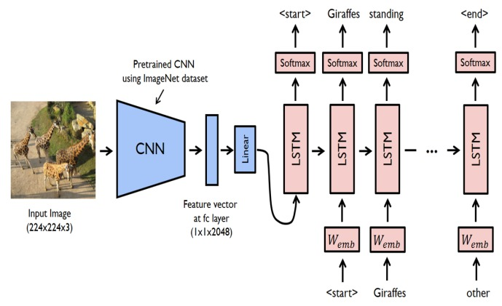

System Architecture

Slide 3
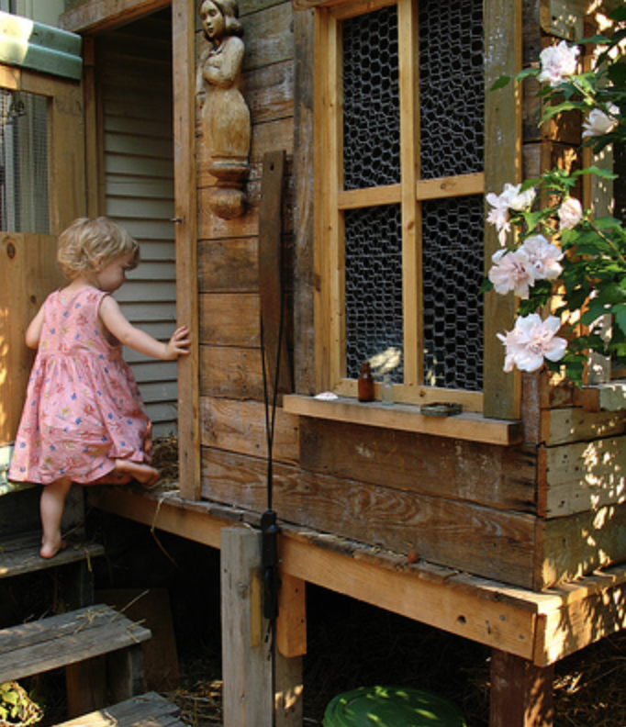
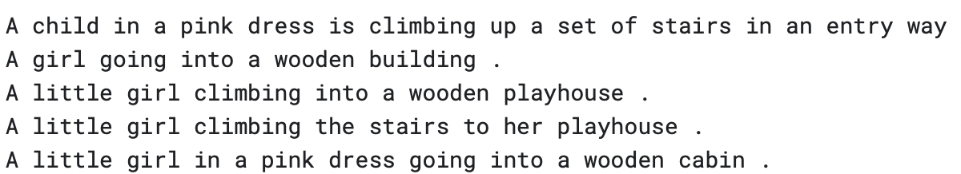
Dataset
Used dataset: Flickr8K
8091 images with five captions for each image.
Content variety - The images in Flickr8k cover a wide variety of topics, suitable dataset suitable to evaluate model’s ability to generate captions for diverse visual content input.
(a)
(b)
(a) Input image (b) Corresponding caption provided in training dataset

Slide 4
PREPROCESSING
Creating dictionaries to map image IDs to captions.
Extracting image features using ResNet50 and forming a dictionary for image encodings.
Setting hyperparameters like vocabulary size and maximum sequence length.
Creating dictionaries to map words to indices and indices to words.
To process the model's data, complex English words are represented numerically by mapping each word in the vocabulary to a unique index value.

Slide 5
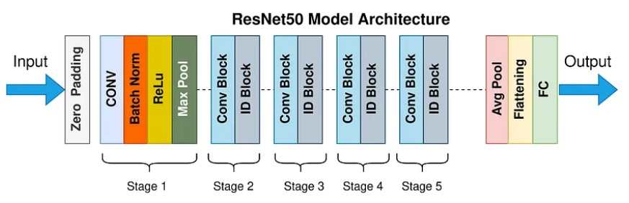
RESNET50

Slide 6
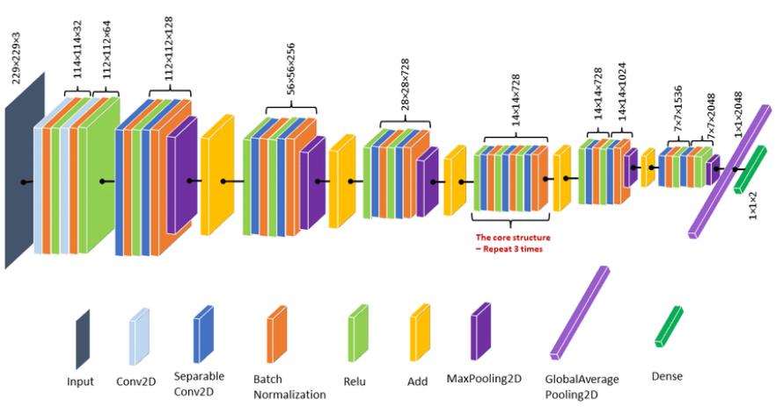
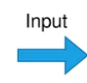
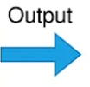
XCEPTION

Slide 7
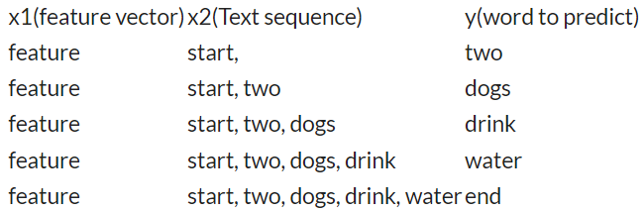
Data generator function
Function purpose: Prepares data for image captioning models.
Inputs: Encoded captions, image features, batch size.
Process: Iterates, creates samples, pads, and encodes.
Benefits: Organizes, enhances training, improves accuracy.
Key Role: Crucial for effective image captioning.

Slide 8
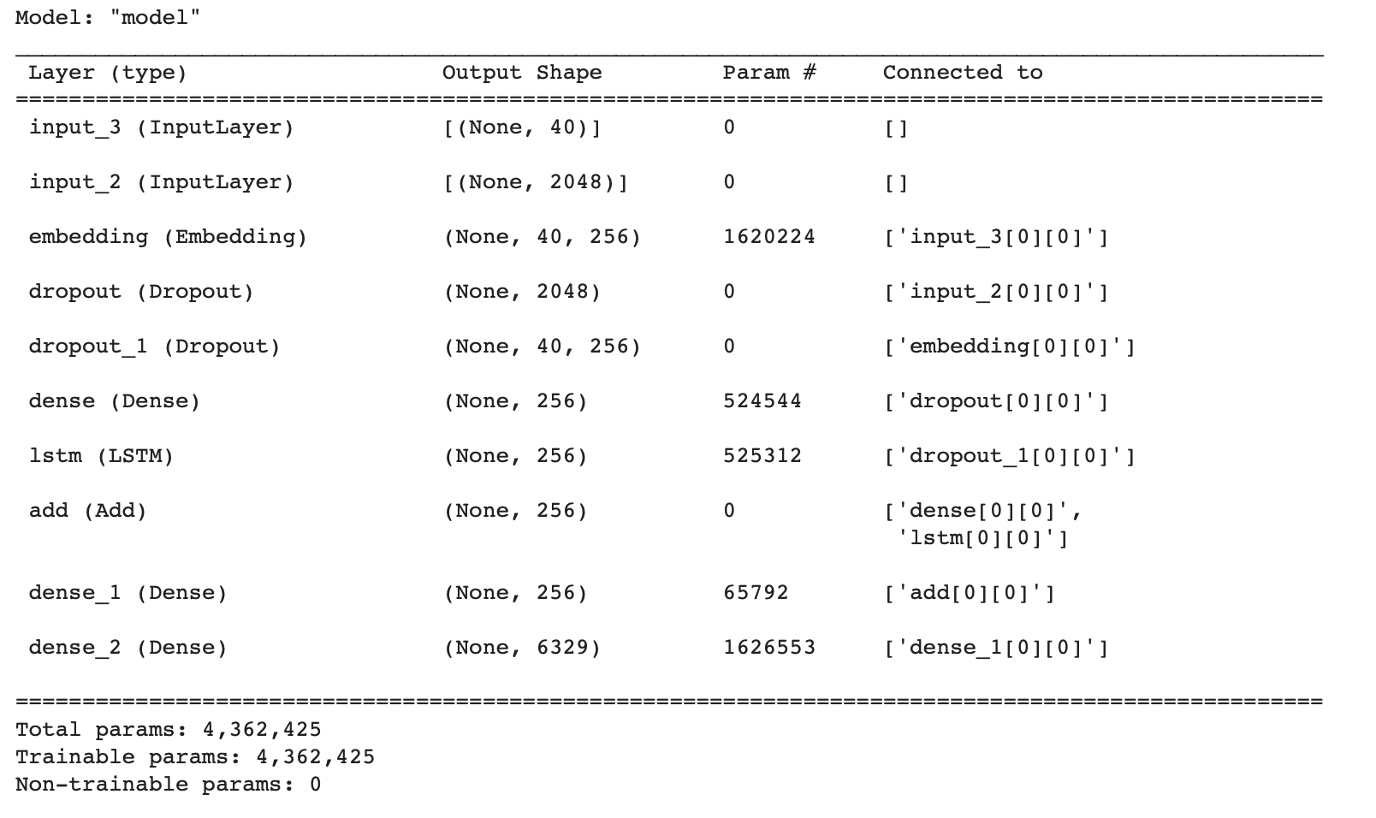
Model architecture
Feature Extractor:
Utilizes dense layer.
Extracts features from 2048-sized images.
Reduces dimensions to 256 nodes.
Sequence Processor:
Employs LSTM layer.
Handles textual input.
Utilizes embedded layer.
Decoder:
Merges outputs of previous layers.
Processed by dense layer.
Generates final predictions.
Compiling the model with suitable optimizer and loss functions

Slide 9
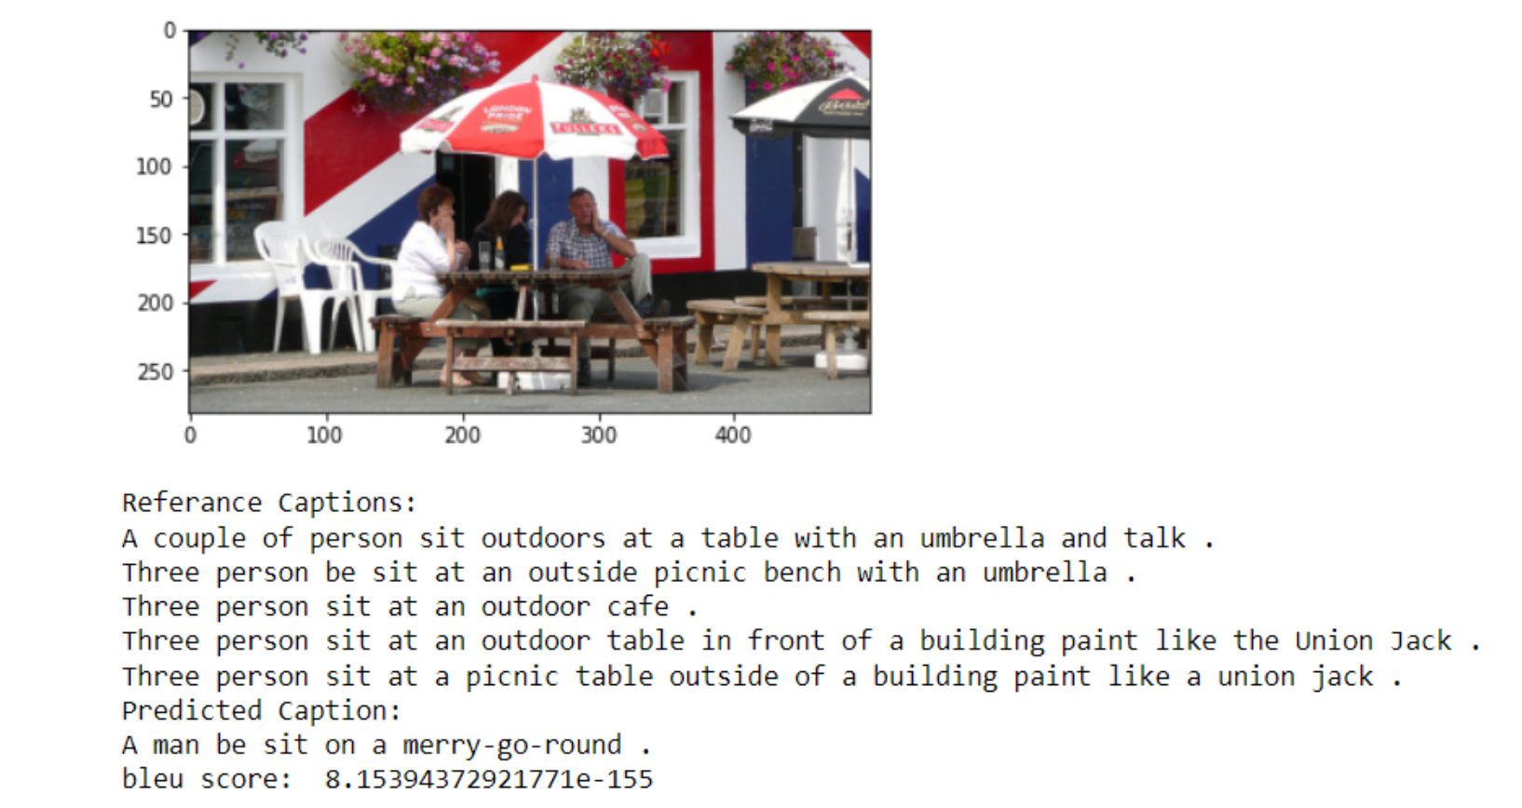
Training
Output
Training
Training the model using the data generator.
Utilizing
Utilizing the Greedy Search approach for caption generation.
Implementing
Implementing a greedy search function for predicting captions.
Displaying
Displaying sample image predictions and comparing them with reference captions.
Calculating
Calculating BLEU scores for caption evaluation.

Slide 10
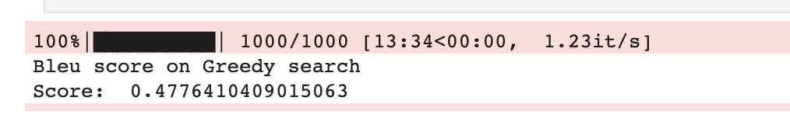
BLEU Metric:
BLEU Metric, a vital NLP evaluation tool-
gauges machine-generated text quality against human references, producing scores from 0 to 1
widely applied to assess machine translation, summarization, and text generation systems, offers a quantifiable measure of linguistic fidelity and correctness
Higher BLEU scores indicate closer alignment with human references
Greedy Search:
selects each word in the image caption sequentially based on the highest predicted probability
may not always yield the globally optimal caption.

Slide 11
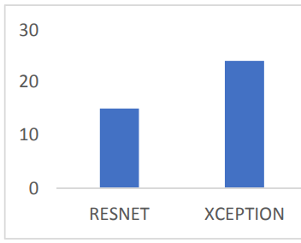
Improvement
XCEPTION Model instead of RESNET 50
Computational Efficiency: Reduced model complexity and faster training and inference.
Enhanced Feature Learning: Improved image feature extraction, leading to higher-quality captions.
Reduced Overfitting: Mitigated overfitting, resulting in better generalization.
Handling Correlations: Effective handling of cross-channel and spatial correlations for more coherent captions.

